Slide 1

Case Study: Unacademy
GROUP - 4

Slide 2

Project Overview
Unacademy is India’s largest, online learning platform.
It allows educators to create courses on various subjects and more on thousands of internet-connected devices.
With unacademy, students can watch unlimited ad-free viewing of study content.

Slide 3
Individual Module Assigned
MODULE NAME | ASSIGNED TO
1.Signup | Tanya Tiwari, Bhanushree H S
2.Search | Sanjana S
3.Start learning | Mukul Dev Mahato
4.About us | Aditya Baghel
5.Subscription and payment | Mehendi kote, Simran Ukkali
Signup

Slide 4
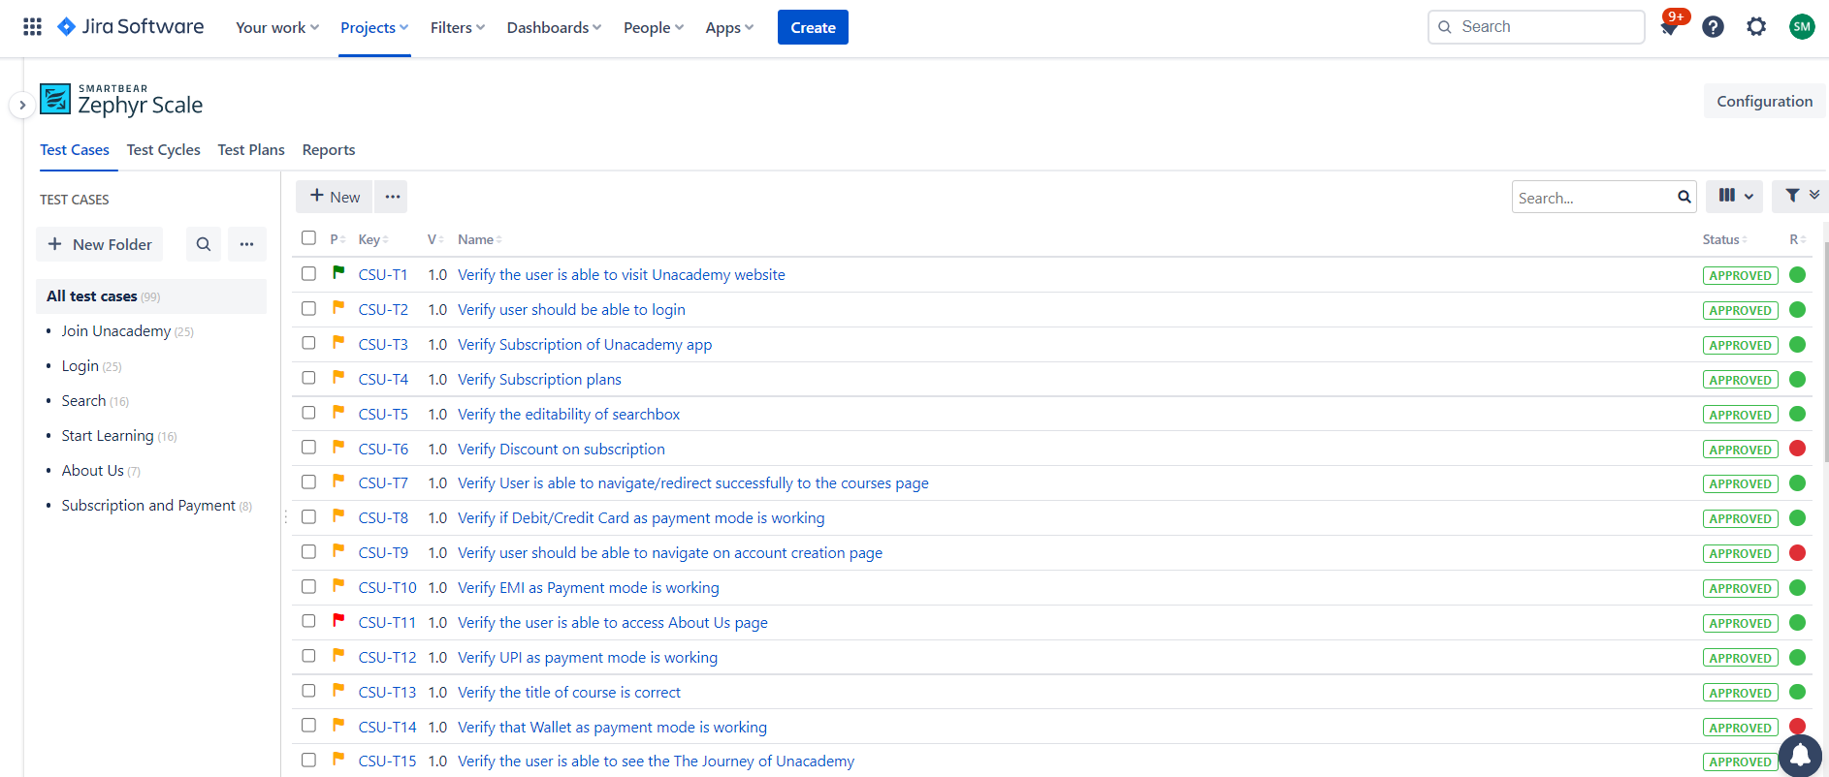
Test Case Snippet

Slide 5
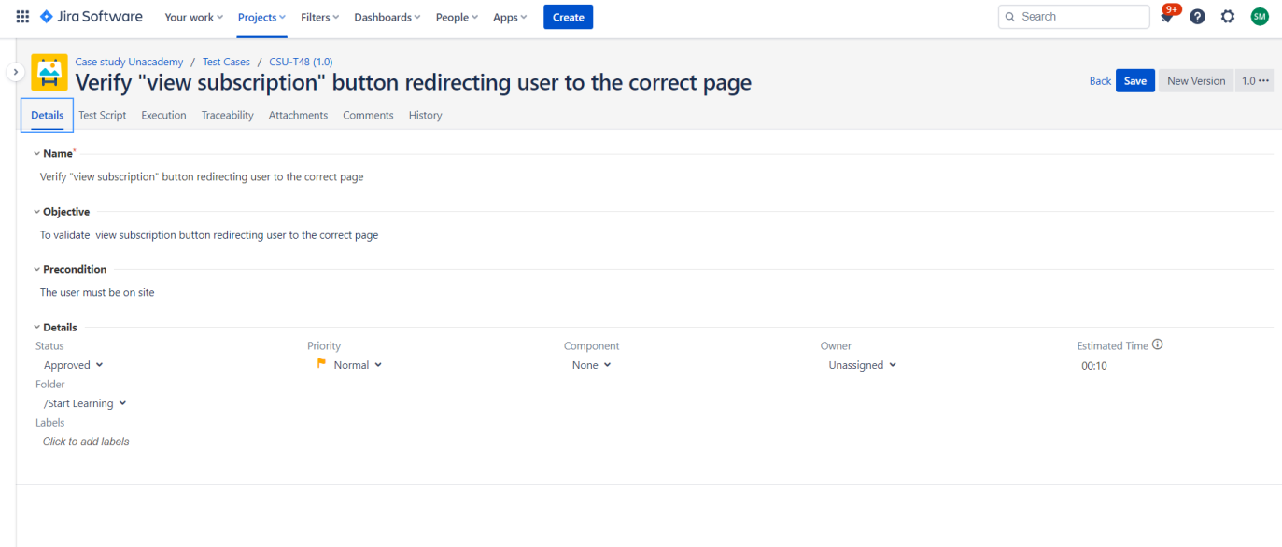
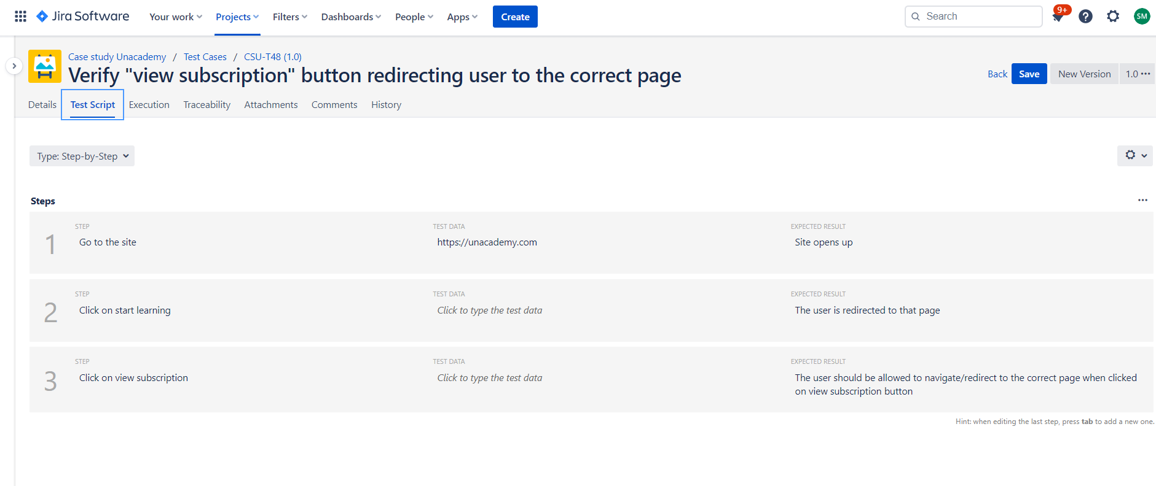

Slide 6
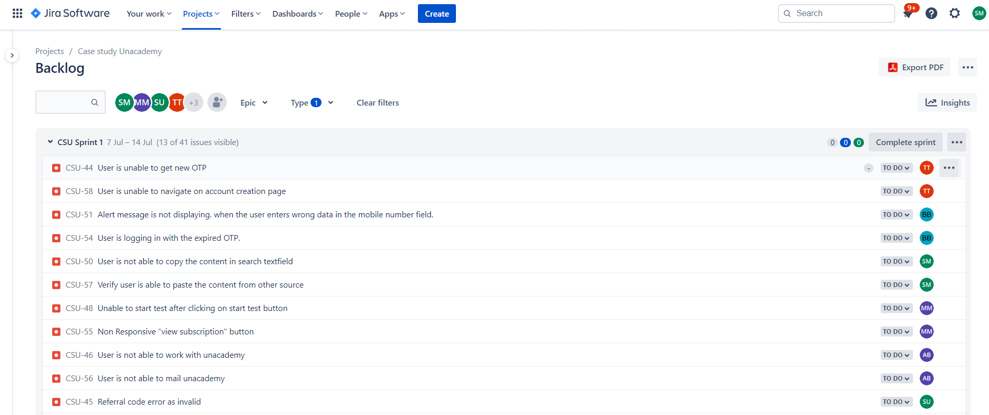
Defect Snippet

Slide 7
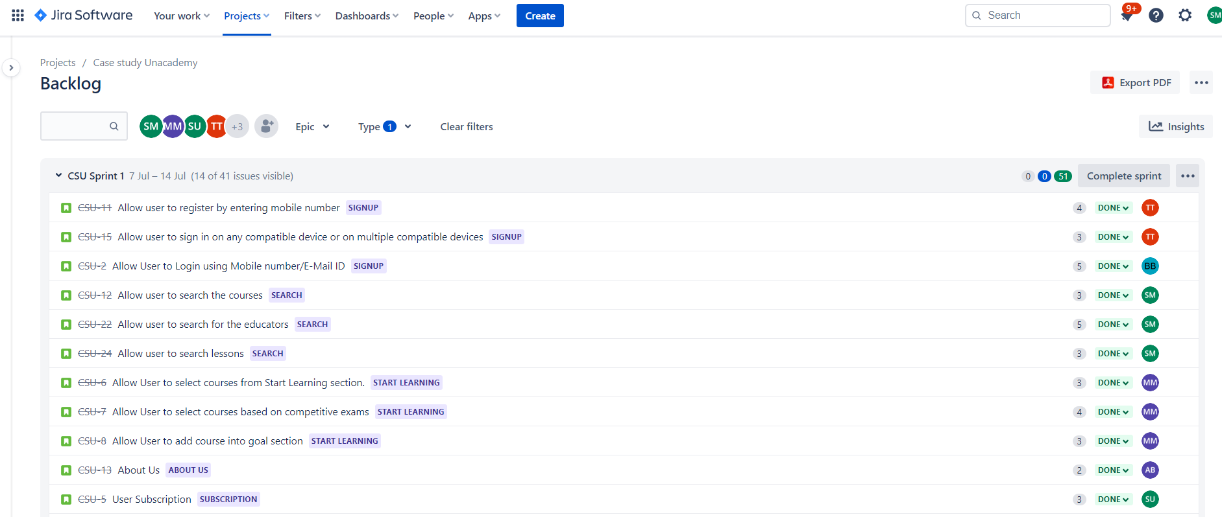
User Stories Snippet

Slide 8
Contribution of Team Members
Bhanushree : Created the project in Jira and invited the team members
Tanya : Assigned everyone to a particular module
Aditya : Started the sprint
Sanjana: Checked everyone’s test cases and verified every test case is executed
Mukul: Created the Dashboard
Mehendi : Checked the status of every issue
Simran: Assigned story points and time estimated to user stories and test cases

Slide 9
Challenges faced by team
Adding team members to the project in Jira.
It was difficult to get access to zephyr scale plugin by the team members.
Team members were confused about the pattern of testcases.
Team members faced difficulty while exporting dashboard to pdf format.
It was difficult to formulate traceability matrix.

Slide 10
How did we overcame the challenges
We discussed with trainer.
We discussed our problem with batchmates from other groups.
We searched through online platforms like google,youtube.
We took reviews from each other which helped us a lot.

Slide 11
Learnings from Jira tool
Creating issues: Stories, epics, task, bugs.
Creation of SCRUM based sprints.
Added zephyr scale plug-in and created testcases.
Testcase execution.
Linking stories, epics, tasks, bugs together.
Creation of dashboard and traceability matrix.
Changing the status of issues in the sprint board.
Jira Link: https://bhanus.atlassian.net/jira/software/projects/CSU/boards/2/backlog
Git Link: https://github.com/Mukuldev21/Capgemini-Sprint-1-Group-4

Slide 12
User stories, testcase, defects, testcase passed, testcase failed count
Tester | User stories | Test case | Defects | Test case passed | Test case failed
Tanya Tiwari | 2 | 25 | 2 | 23 | 2
BhanushreeH S | 1 | 25 | 2 | 23 | 2
Sanjana S | 3 | 16 | 2 | 14 | 2
Mukul Dev Mahato | 3 | 16 | 2 | 14 | 2
Aditya Baghel | 1 | 7 | 3 | 4 | 3
Mehendi Kote | 1 | 5 | 2 | 3 | 2
Simran Ukkali | 3 | 3 | 1 | 2 | 1

Slide 13
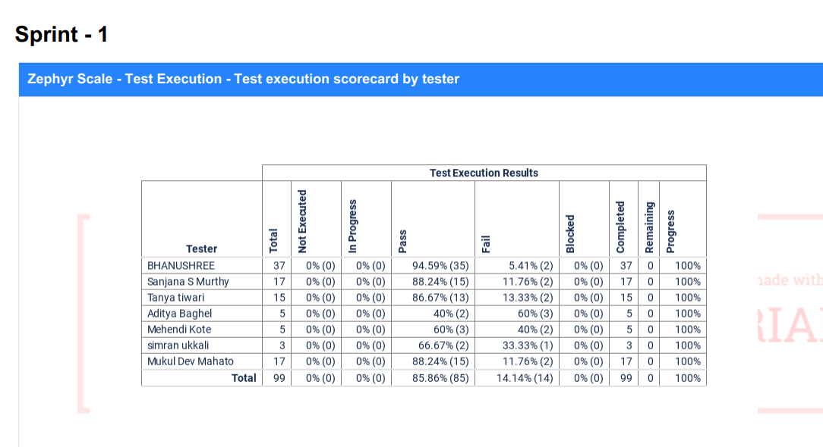
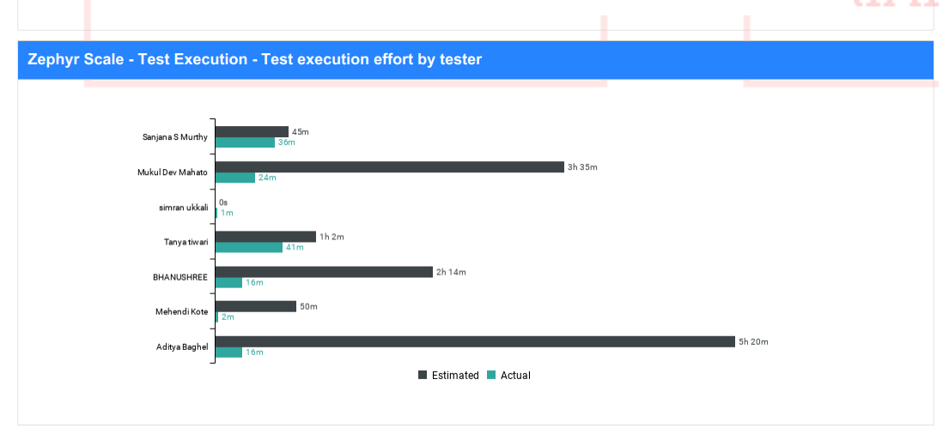
Dashboard
Sprint 1 Dashboard
Zephyr scale – Test Execution Score card
Zephyr scale – Test Execution effort by tester
Pie chart case study unacademy
Sprint Burndown gadget

Slide 14
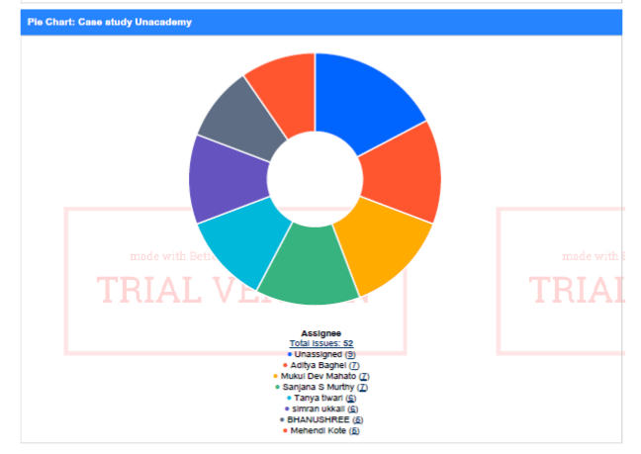
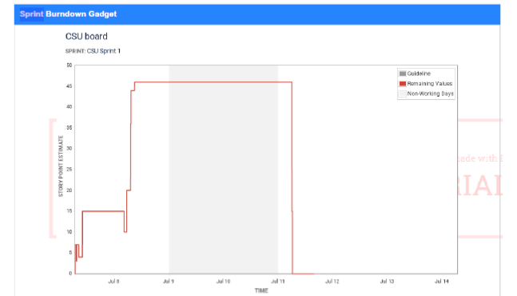

Slide 15
Thank You
Team Members
Tanya Tiwari,
Bhanushree H S
Sanjana S
Mukul Dev Mahato
Aditya Baghel
Mehendi kote,
Simran Ukkali

